Slide 1

Boolean & Relational Values
Control-flow Constructs
Comp 412
COMP 412
FALL 2010
Copyright 2010, Keith D. Cooper & Linda Torczon, all rights reserved.
Students enrolled in Comp 412 at Rice University have explicit permission to make copies of these materials for their personal use.
Faculty from other educational institutions may use these materials for nonprofit educational purposes, provided this copyright notice is preserved.

Slide 2
Boolean & Relational Values
How should the compiler represent them?
Answer depends on the target machine
Two classic approaches
Numerical (explicit) representation
Positional (implicit) representation
Best choice depends on both context and ISA
This material is drawn from §7.4 in EaC, where it is presented in more depth with more examples. You should read that section, along with the rest of Chapter 7. Lecture will not cover all the material in Chapter 7, but you are responsible for it.
Implementation of booleans, relational expressions & control flow constructs varies widely with the ISA
Comp 412, Fall 2010

Slide 3
Boolean & Relational Expressions
First, we need to recognize boolean & relational expressions
Expr | → | Expr ∨ AndTerm
 | | | AndTerm
AndTerm | → | AndTerm ∧ RelExpr
 | | | RelExpr
RelExpr | → | RelExpr < NumExpr
 | | | RelExpr ≤ NumExpr
 | | | RelExpr = NumExpr
 | | | RelExpr ≠ NumExpr
 | | | RelExpr ≥ NumExpr
 | | | RelExpr > NumExpr
NumExpr | → | NumExpr + Term
 | | | NumExpr - Term
 | | | Term
Term | → | Term × Value
 | | | Term ÷ Value
 | | | Value
Value | → | ¬ Factor
 | | | Factor
Factor | | | ( Expr )
 | | | number
 | | | Reference
Comp 412, Fall 2010
Reference derives a name, a subscripted name, a structure reference, a string reference, …

Slide 4
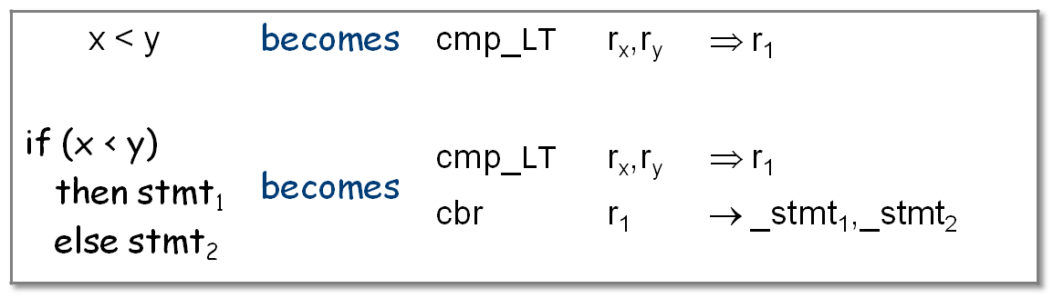
Boolean & Relational Values
Next, we need to represent the values
Numerical representation
Assign values to TRUE and FALSE
Use hardware AND, OR, and NOT operations
Use comparison to get a boolean from a relational expression
Examples
Comp 412, Fall 2010

Slide 5
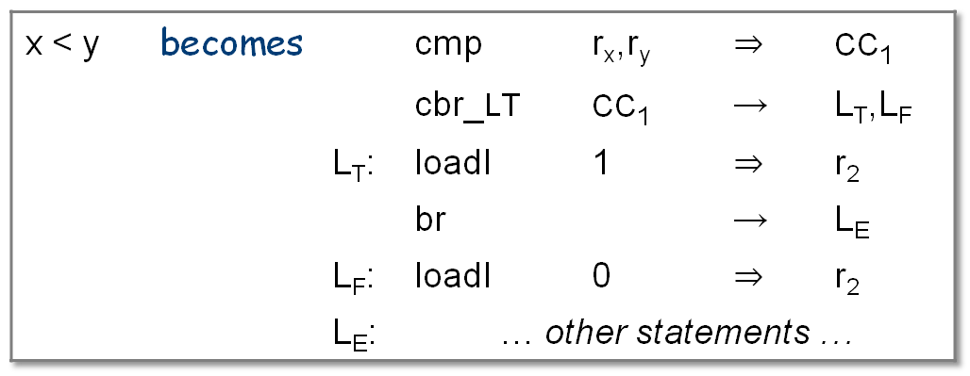
Boolean & Relational Values
What if the ISA uses a condition code?
Must use a conditional branch to interpret result of compare
Necessitates branches in the evaluation
Example
This “positional representation” is much more complex
Comp 412, Fall 2010

Slide 6
Boolean & Relational Values
Editorial comment: (KDC)
CC’s are an evil, seductive idea
What if the ISA uses a condition code?
Must use a conditional branch to interpret result of compare
Necessitates branches in the evaluation
Example
This “positional representation” is much more complex
Condition codes
are an architect’s hack
allow ISA to avoid some comparisons
complicates code for simple cases
Comp 412, Fall 2010

Slide 7
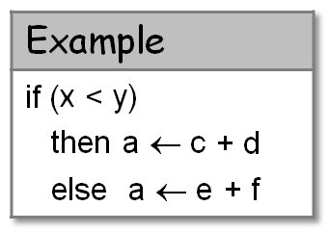
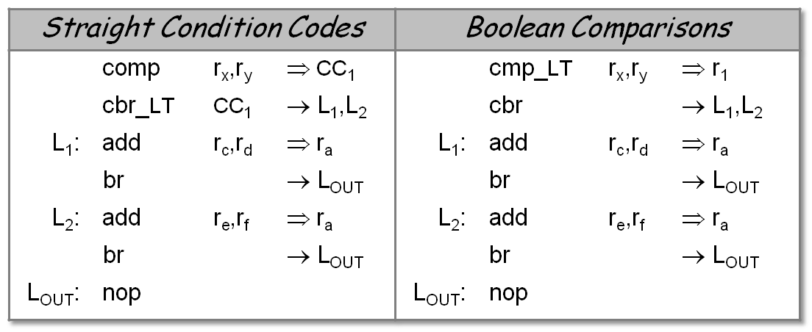
Boolean & Relational Values
The last example actually encoded result in the PC
If result is used to control an operation, that may suffice
Condition code version does not directly produce (x < y)
Boolean version does
Still, there is no significant difference in the code produced
Comp 412, Fall 2010

Slide 8

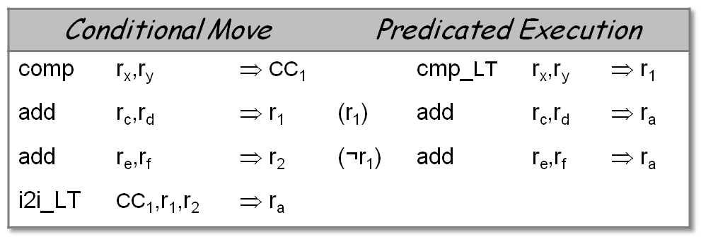
Boolean & Relational Values
Other Architectural Variations
Conditional move & predication both simplify this code
Both versions avoid the branches
Both are shorter than cond’n codes or Boolean-valued compare
Are they better?
Comp 412, Fall 2010

Slide 9
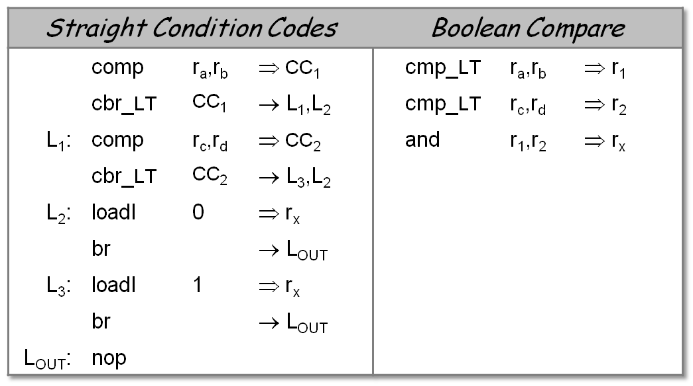
Boolean & Relational Values
Consider the assignment x ← a < b ∧ c < d
Here, Boolean compare produces much better code
Comp 412, Fall 2010

Slide 10
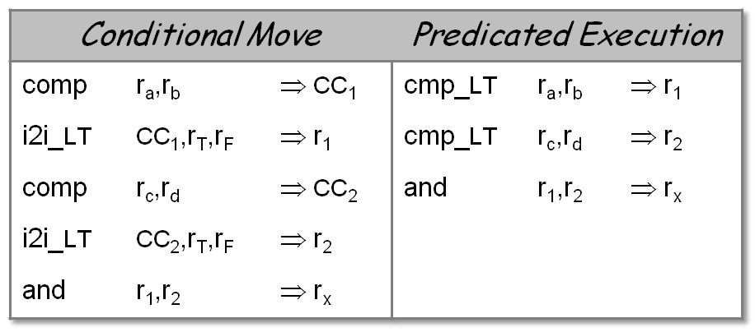
Boolean & Relational Values
Conditional move & predication help here, too
Conditional move is worse than Boolean compare
Predication is identical to Boolean compares
The bottom line:
⇒ Context & hardware determine the appropriate choice
x ← a < b ∧ c < d
Comp 412, Fall 2010
Chapter 7 goes into greater depth; read it.

Slide 11
Control Flow
If-then-else
Follow model for evaluating relationals & booleans with branches
Branching versus predication (e.g., IA-64)
Frequency of execution
  Uneven distribution ⇒ do what it takes to speed common case
Amount of code in each case
  Unequal amounts means predication may waste issue slots
Control flow inside the construct
  Any branching activity within the construct complicates the predicates and makes branches attractive
Comp 412, Fall 2010

Slide 12
Short-circuit Evaluation
Optimize boolean expression evaluation
Once value is determined, skip rest of the evaluation
  if (x or y and z) then …
  If x is true, need not evaluate y or z
    Branch directly to the “then” clause
  On a PDP-11 or a VAX, short circuiting saved time
Modern architectures may favor evaluating full expression
  Rising branch latencies make the short-circuit path expensive
  Conditional move and predication may make full path cheaper
Past: compilers analyzed code to insert short circuits
Future: compilers analyze code to prove legality of full path evaluation where language specifies short circuits
Comp 412, Fall 2010

Slide 13
Control Flow
Loops
Evaluate condition before loop (if needed)
Evaluate condition after loop
Branch back to the top (if needed)
Merges test with last block of loop body
while, for, do, & until all fit this basic model
Pre-test
Loop body
Post-test
Next block
Comp 412, Fall 2010

Slide 14
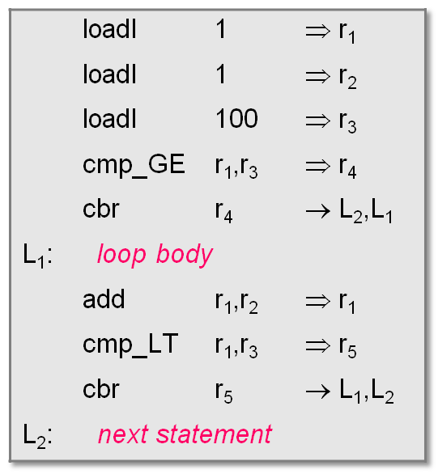
Implementing Loops
for (i = 1; i< 100; i++) { loop body }
next statement
Initialization
Pre-test
Post-test
Comp 412, Fall 2010

Slide 15
Break statements
Many modern programming languages include a break
Exits from the innermost control-flow statement
  Out of the innermost loop
  Out of a case statement
Translates into a jump
Targets statement outside control-
flow construct
Creates multiple-exit construct
Skip in loop goes to next iteration
Only make sense if loop has > 1 block
Pre-test
Loop head
Break in B 1
B 1
B 2
Skip in B 2
Post-test
Next block
Comp 412, Fall 2010

Slide 16
Control Flow
Case Statements
Evaluate the controlling expression
Branch to the selected case
Execute the code for that case
Branch to the statement after the case
Parts 1, 3, & 4 are well understood, part 2 is the key
Comp 412, Fall 2010

Slide 17
Control Flow
Case Statements
Evaluate the controlling expression
Branch to the selected case
Execute the code for that case
Branch to the statement after the case (use break)
Parts 1, 3, & 4 are well understood, part 2 is the key
Strategies
Linear search (nested if-then-else constructs)
Build a table of case expressions & binary search it
Directly compute an address (requires dense case set)
Case statements are a place where attention to code shape pays off handsomely.
Comp 412, Fall 2010

